Slide 1
2026 - 2031 Transportation Improvement Program
City Council
June 3, 2025

Slide 2
Compliance with State Law RCW 35.77.010
State Law requires that the legislative body of each city and town, pursuant to one or more public hearings thereon, shall prepare and adopt a comprehensive transportation program for the ensuing six calendar years.
Visit the website link for comments/questions:
https://www.ci.richland.wa.us/departments/public-works/traffic-and-streets/transportation-planning

Slide 3
Six-Year Transportation Improvement Program
State-wide coordinated financial planning document for transportation system improvements
Coordinated between local agencies (Cities, Counties, Transit agencies), regional planning organizations (MPO’s, RTPO’s) and Washington State Department of Transportation
Queues up transportation system improvements that may be funded in the coming six-year planning horizon
Higher priority, fully or partially funded projects listed in early years, lower priority unfunded projects listed toward the end of the six-year period

Slide 4
City Public Process
Web posting of Draft TIP
Parks & Rec Commission Review for Active Transportation Elements
Planning Commission Review for Comprehensive Plan compliance
Council Public Hearing and Action

Slide 5
2026 – 2031 Draft TIP – Removed Projects
Removed Projects
Downtown Connectivity Improvements – 2025 construction start
Dallas/Ava Intersection Improvements – 2025 construction
Queensgate Dr Extension – Truman to Kingsgate – 2025 construction
Systemic Pedestrian Crossing Safety Improvements Ph 1 – 2025 construction start
Center Parkway South Extension
Notes:
Projects you will not see on the TIP. Pavement Preservation Program funded projects – micro, slurry, HMA overlays; CDBG ADA projects;

Slide 6
2026 – 2031 Draft TIP – Funded Projects
# | Project | Status | Description
1 | SR-240/Aaron Interchange | Partially funded* | Roundabout, fly-over bridge, connection to Chamna. *Design
2 | SR-240 Pedestrian Crossing | Partially funded | ped/bike bridge crossing SR-240
3 | S. GWW Pavement Preservation | Funded | Asphalt overlay
4 | Center Parkway South Extension | Funded | New road connection between Bellerive and Leslie
5 | Systemic Pedestrian Crossing Safety Improvements Ph 2 | Funded | RRFBs, signs, markings

Slide 7
2026 – 2031 Draft TIP – Funded Projects
# | Project | Status | Description
6 | Systemic Stop Controlled Intersection Safety Improv. | Funded | Mini-roundabouts and intersection warning devices
9 | SR-240 / Airport Way Pedestrian Crossing | Partially Funded | connection across SR-240 and Shelterbelt Trail
10 | Central Richland Active Transportation Improvements | Partially Funded* | Bike lanes, sidewalk, RRFBs *Planning
12 | Gage / Leslie Intersection Improvements | Funded | Capacity improvements, signal upgrades
13 | Duportail / Kennedy Intersection Improvements | Funded | Roundabout

Slide 8
2026 – 2031 Draft TIP – Funded Projects
# | Project | Status | Description
15 | Duportail / Driveway Intersection Improvements | Funded | Roundabout
16 | Queensgate / Duportail Intersection Improvements | Funded | Capacity improvements, signal upgrades
18 | GWW Sidewalk Improvements | Funded | Adds sidewalk between Comstock and Bradley

Slide 9
2026 – 2031 Draft TIP – Unfunded Priorities
# | Project | Status | Description
7 | Safe Routes to School Improvements | Unfunded | RRFBs, bike lanes, sidewalk, school zone upgrades
8 | Gage Boulevard Improvements | Unfunded | includes bike lanes

Slide 10
2026 – 2031 Draft TIP – New Projects
New projects
2025 – 2030 TIP Amended in January to add GWW Sidewalk, GWW Pavement Preservation
Not shown on TIP
Pavement Preservation Program
City-wide Transportation System Plan

Slide 11
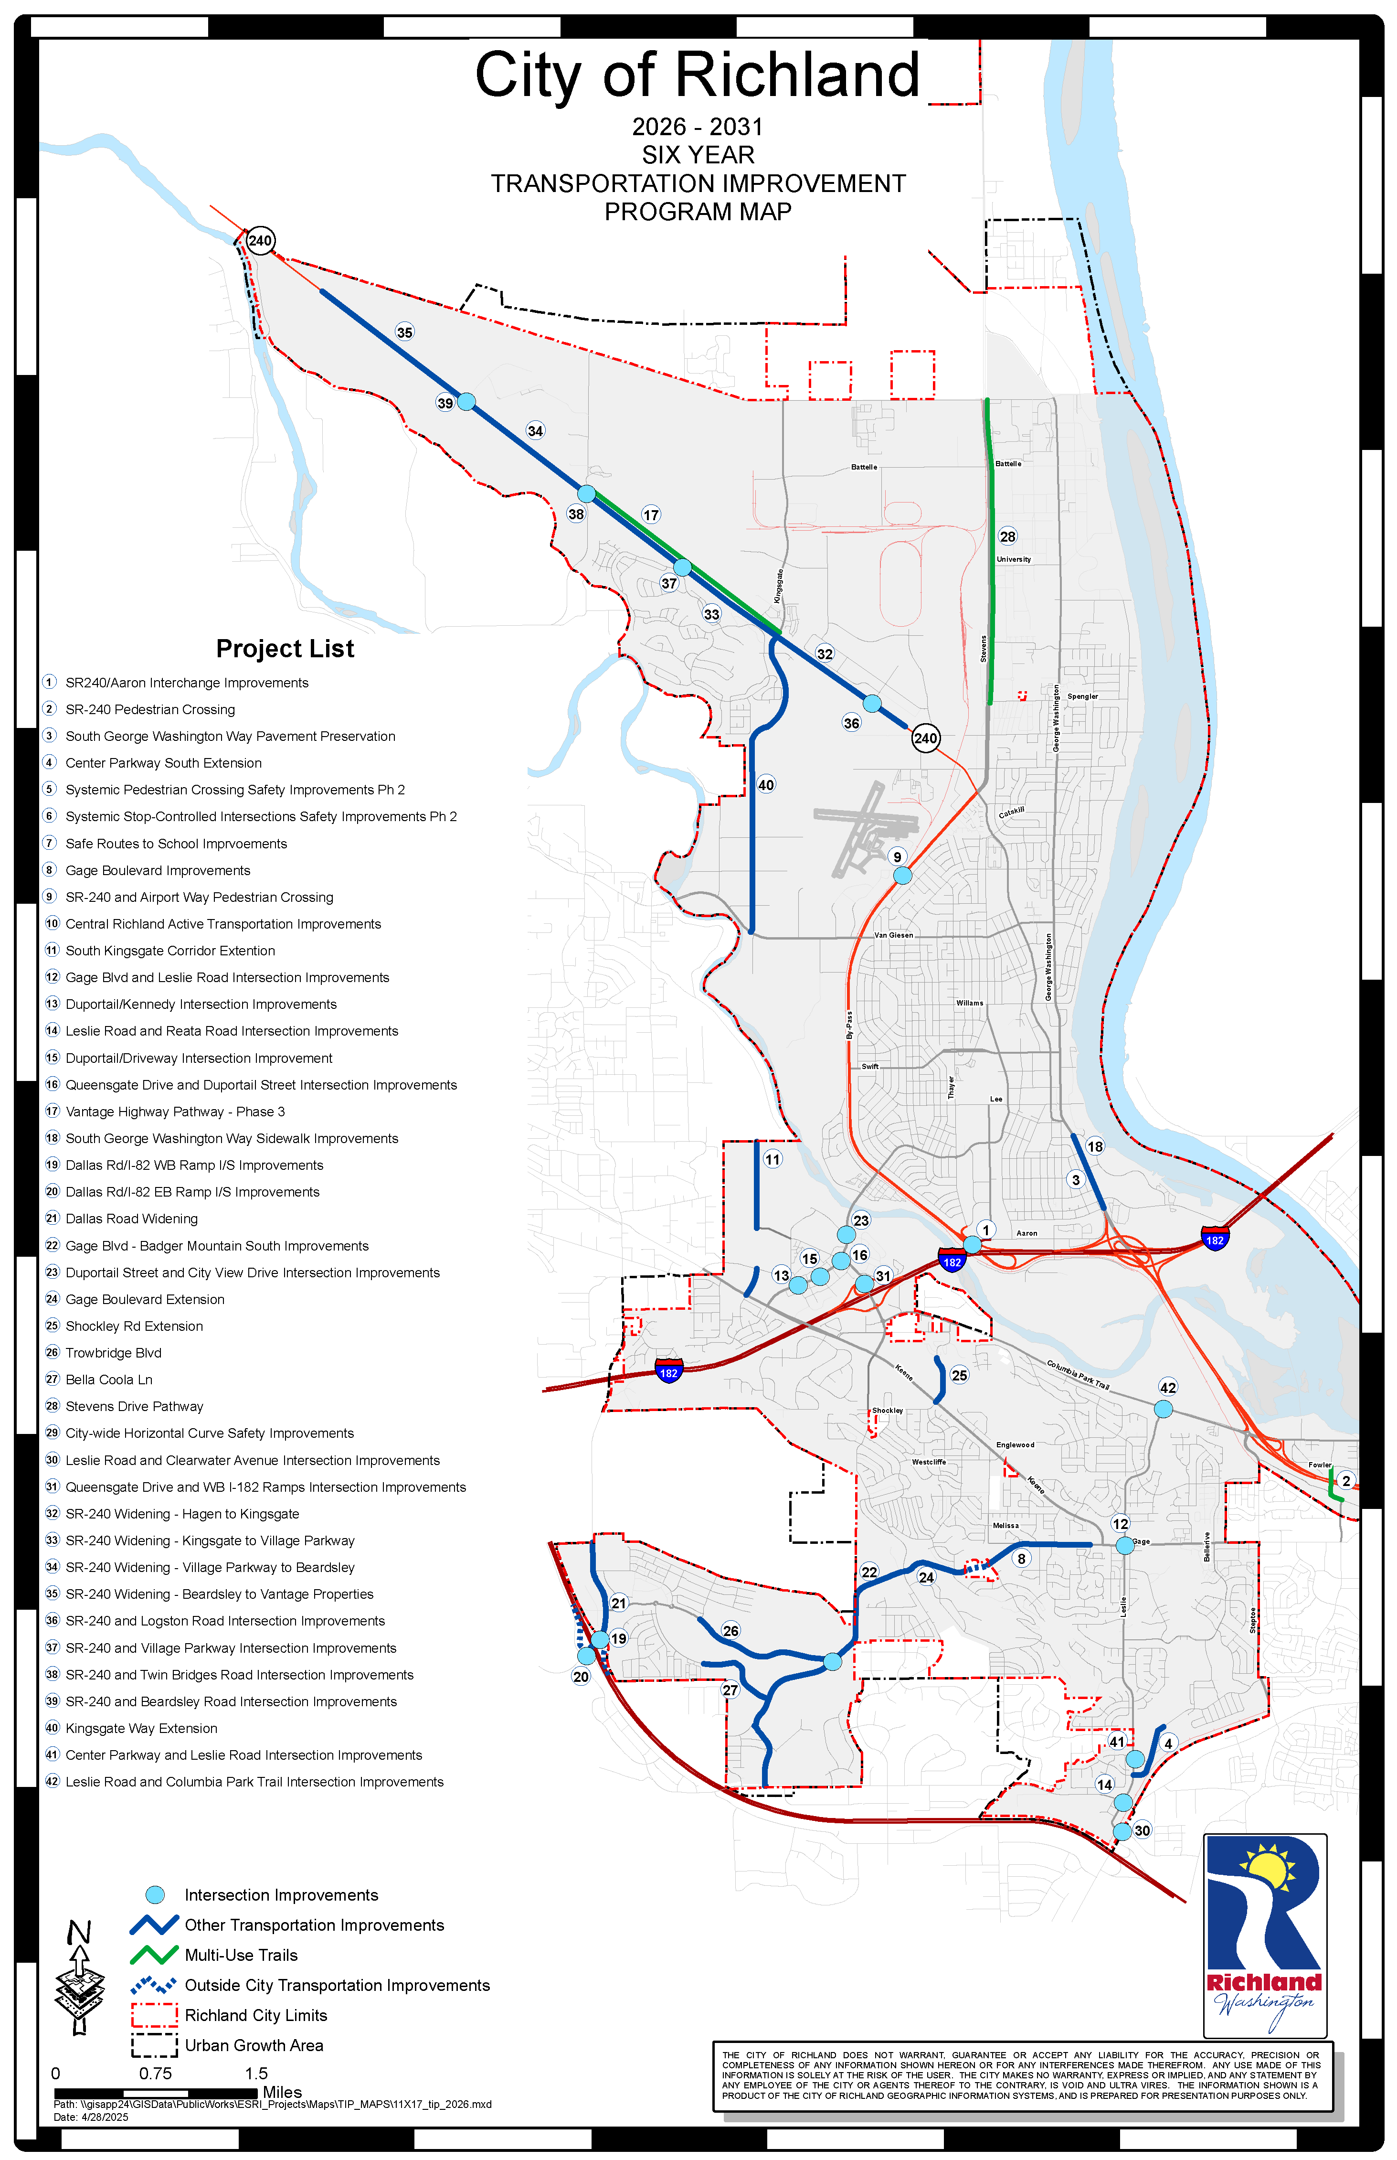

Slide 12
Path Forward
April Draft TIP posted to City web site
https://www.ci.richland.wa.us/departments/public-works/traffic-and-streets/transportation-planning
May 8 P&R Commission – Public meeting and recommendation to Council
May 28 Planning Commission – Public Meeting and recommendation to Council
June 3 City Council – Public Hearing and Resolution adopting TIP
June 30 Submission to MPO due
Summer BFCOG Regional TIP Public Process and Adoption
Fall Washington STIP assembly and approval

Slide 13
Staff Recommendation
Recommend adopting the 2026-2031 Transportation Improvement Program

